Slide 1

PERSONALIZED COMMERCE
1P IDENTITY, DATA & CONTENT
Presented By Diaz Nesamoney, President & CEO, Jivox
March 1, 2022

Slide 2
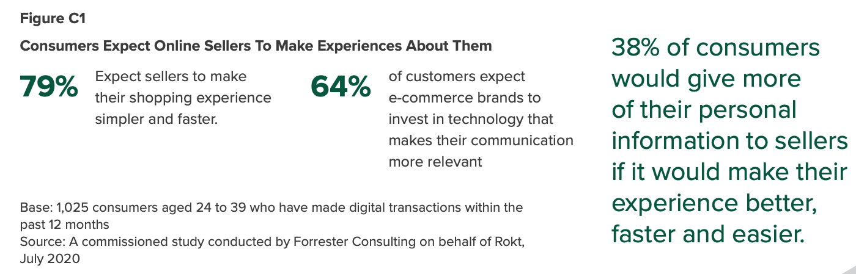
Shoppers demand personalization
…. but only 38% of brands currently deliver relevant and personalized experiences

Slide 3

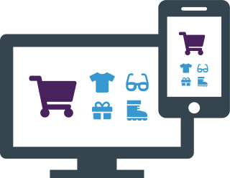
PERSONALIZED COMMERCE
Content-to-Commerce
T
CONTENT & CREATIVE ASSETS
DISPLAY
MOBILE
OMNICHANNEL DELIVERY
EMAIL
DYNAMIC CONTENT AUTOMATION
PRODUCT FEEDS
VIDEO
IDENTITY
MANAGEMENT
DATA-DRIVEN DECISIONING
PERSONALIZED COMMERCE
SOCIAL MEDIA
CUSTOMER DATA
WEBSITE
CTV/ OTT
NATIVE ADS
CONTEXTUAL DATA
3

Slide 4




Dynamic content automation
Produce Thousands Of Ads At Scale Using Creative Automation
Creative Master
Creative Versions

Slide 5

DATA DRIVES CONTENT DECISIONS
The Key To Hyper-Personalization
Rules
WEBSITE DATA
Content Optimization
PRODUCT DATA
DECISION GRAPH
CRM/LOYALTY DATA
AI-based Recommendations
STORE DATA
CONTEXTUAL DATA

Slide 6



Personalization requires identity
Identity Fragmentation Requires an Identity Graph
Trade Desk Unified ID
Proprietary Customer ID
First-Party ID
LiveRamp Ramp ID
Jivox IQiD
ID Graph
CDP ID
Topics API
DMP iD
IQiD is Jivox’s proprietary identity graph that offers brands a first-party identity
Uses 1P domain and PII for ID
100% privacy compliant
Integrates with Data Management Platforms (DMP) and Customer Data Platforms (CDP)
Provides brands data from multiple IDs for analytics and attribution
6

Slide 7



HOLISTIC
CUSTOMER JOURNEY
A single source of truth for journey and spend attribution across paid and owned media
7

Slide 8


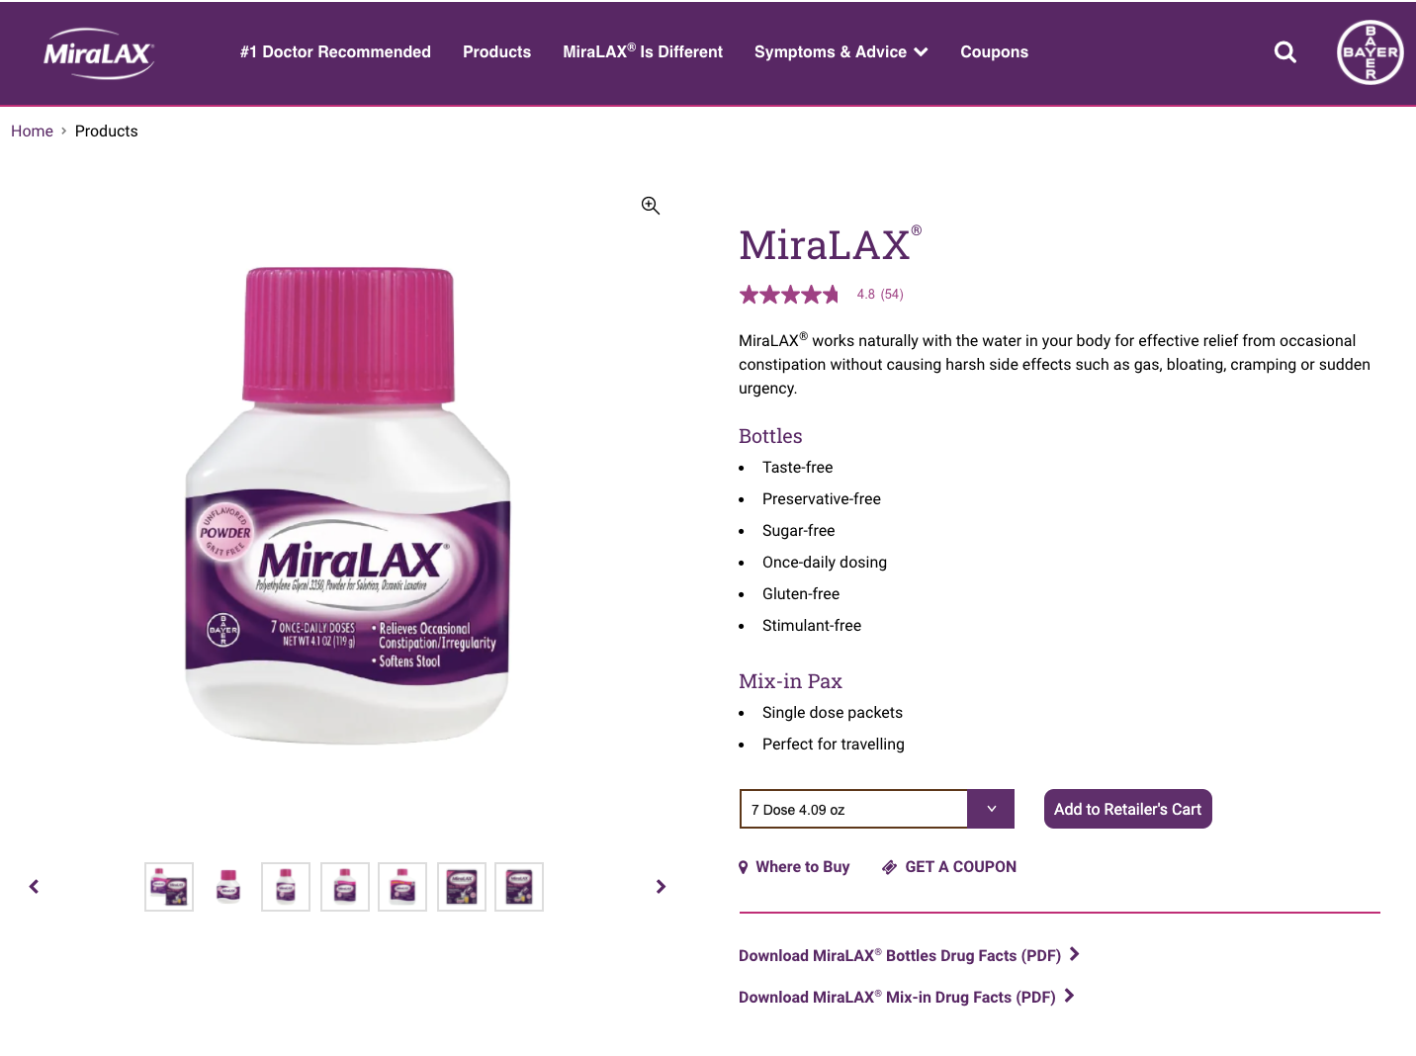
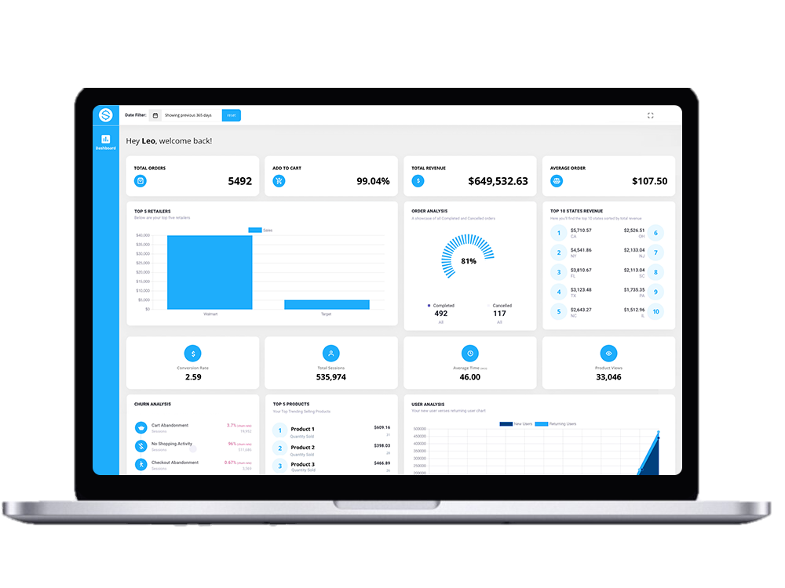
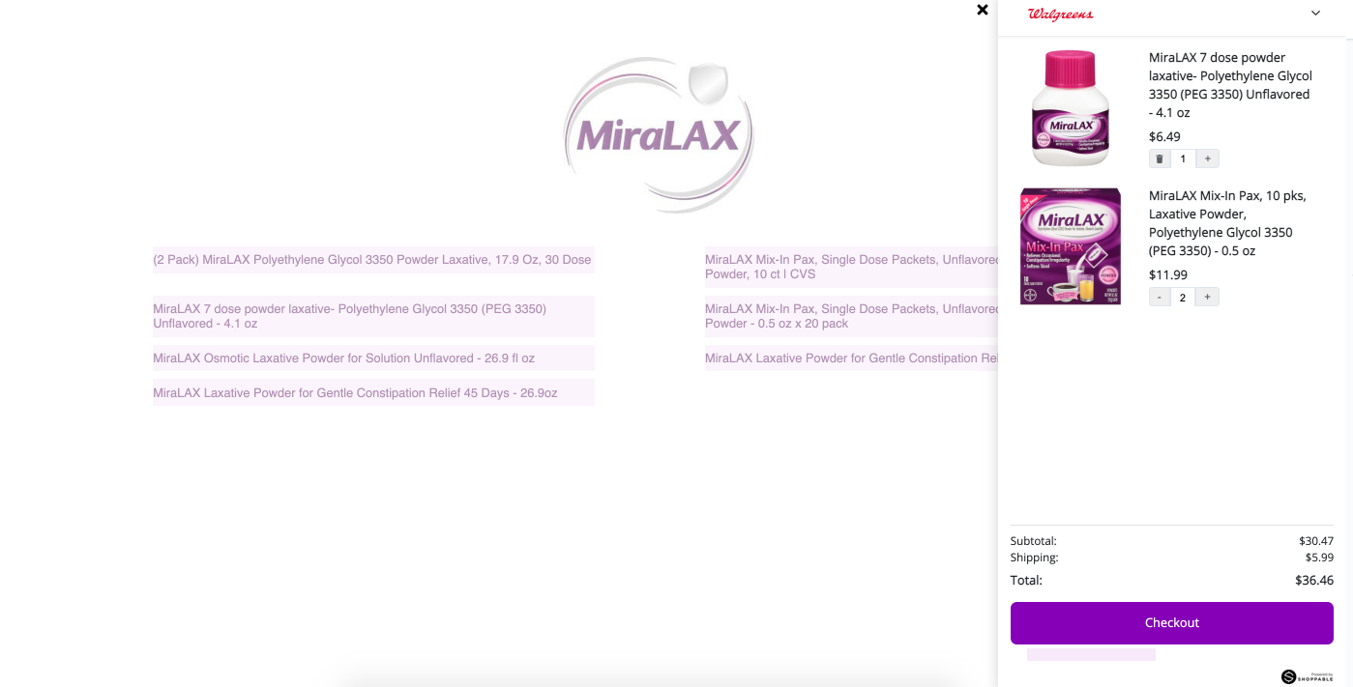



SHOPPABLE ADS: 1-CLICK e-COMMERCE
The Simplicity Of Headless Commerce Marketing
Consumer receives a personalized ad
Consumer clicks to a shoppable landing page within the ad, selects the product SKU and checks out
All purchase activity is tracked in real time
An order is placed with the e-tailer via a headless commerce API for fulfillment
8

Slide 9






Measurement: data CLEAN ROOMS
A Secure Space For Joint Data Analysis
DATA
CLEAN
ROOM
ANALYTICS
Automate data flows to Brand data warehouse & enables scalable ad-hoc manipulation of granular data
ATTRIBUTION
BRAND CONTROL
OVER DATA
Connect with partner data to match user IDs, amplify insights & understand the customer journey - without sharing sensitive data with Jivox
CAMPAIGN DATA
PRIVACY-FIRST
REAL-TIME DATA FLOW
AUDIENCE
Use granular insights from Jivox to create micro-segmented audiences in CDP to further personalize experiences
ACCESSIBLE TO BI TOOLS
Notes:
The second part of this upgrade is the Data Clean Room
We are making this available to customers early in Q1 2022
This is a secure space for Joint Data Analysis
Under the pressure of increased privacy regulation in the marketing world, alongside increasing walled gardens
Many businesses are becoming interested in the concept of data clean rooms to stitch data sources together and perform analysis for a more holistic view of performance
They provide a safe place for multiple companies or teams to bring data together
This could be the Jivox log level campaign data + Brand’s own sales data and information on customer profiles + Partner data such as attribution or audience data from acxiom, liveramp etc
They Clean Room offers controls to brands to determine permissions for partners to analyze and join data sets and keep control of their data
There are many use cases for this including cross channel media measurement and attribution

Slide 10
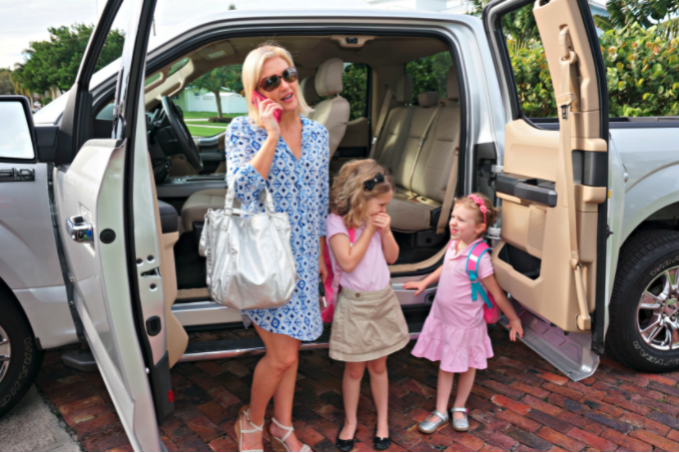
Advertising driven by Retail media
What’s The Future?
THE EVOLVING USE OF DATA
1st Wave: Search
3rd Wave: Purchase Data
2nd Wave: Audiences & Demographics
Data is the key to personalization
What you’ve bought shows the intent of what you’re likely to buy
Who you are is only part of the story; the other part is what you buy
Mom and girls driving in a Ford truck.
But why are most Ford ads targeting and featuring men?

Slide 11

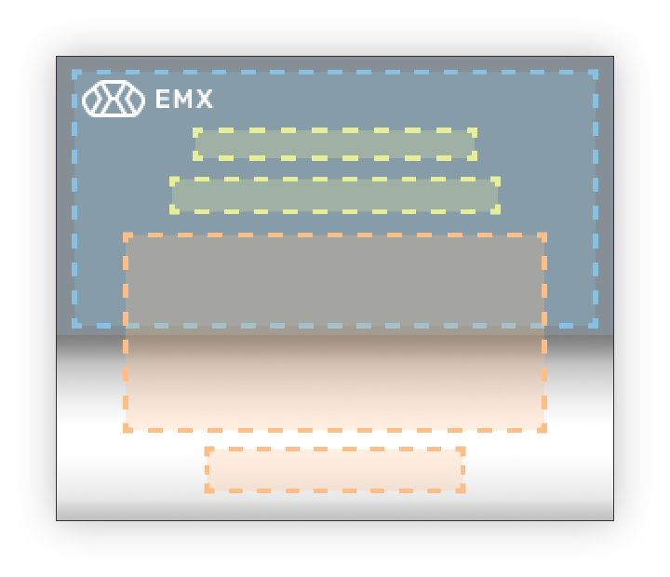






JIVOX PERSONALIZED COMMERCE MARKETING
DISPLAY
MOBILE
CONTEXTUAL DATA
RAW ASSETS
EMAIL
CREATIVE MASTER
VIDEO
REAL-TIME OPTIMIZATION
3rd PARTY DATA
1st PARTY BRAND DATA
SOCIAL MEDIA
WEBSITE
CTV/ OTT
CREATIVE AUTOMATION
DATA-DRIVEN,
AI-BASED DECISIONING
NATIVE ADS
OMNI-CHANNEL DELIVERY

Slide 12
THANK YOU!
Your Personalization Journey STARTS HERE
diaz@jivox.com

