Slide 1
JIVOX AND LIVERAMP RAMPID
INTEGRATION FOR FIRST-PARTY AND COOKIELESS IDENTITY

Slide 2
LIVERAMP RAMPID & JIVOX
Why it matters
With the demise of third-party cookies and the emergence of privacy regulations such as CCPA and GDPR, brands must rely on their user-consented first-party data to continue to personalize ads to customers.
LiveRamp’s RampID is one of the largest and most accurate people-based identity graphs. Brands use LiveRamp to connect their offline and online customer data while remaining privacy-first and eliminating dependence on third-party cookies.
By integrating with LiveRamp’s RampID, Jivox provides brands a way to personalize without third-party cookies and leverage their own user-consented data.

Slide 3
Iqid: FIRST-Party identity graph
No Third-party Cookies or Fingerprinting
Brand First-party Domain
www
Hybrid Cloud tech runs within the brand’s first-party domain
Brand Site/CRM
Open platform: Integrates with brand’s data and consent management
IDENTITY
CONTAINER
Media
Privacy First: GDPR and CCPA compliant
IQiD HUB
WITH BRAND DATA
JIVOX DCO SERVER
No third-party cookies or fingerprinting
THE ONLY DCO PLATFORM IN THE MARKET TO USE FIRST-PARTY IDENTITY TECHNOLOGY
Notes:
Digital Marketing – Relevance and Precision
Data about consumers
key to finding relevant audiences
key to delivering a precise message to an individual
Identifying a user
Owned media – email, login, other PII
Paid media – 3rd party cookies and syncs across ad tech
Browsers under pressure to implement consented models
3rd party cookies, fingerprinting etc.

Slide 4
LIVERAMP RAMPID & JIVOX
Key Benefit
ENABLING PRIVACY-FIRST, OMNICHANNEL PERSONALIZATION FOR BRANDS
Leverage first-party data for personalization
Brands can leverage consented first-party user data to deliver personalized content across different devices and channels, including walled gardens such as Facebook.
Identify users across channels, devices, and browsers
Brands can identify users across multiples devices, channels, and browsers without relying on multiple cookies or IP addresses. This ensures continuity in ad serving and provides insight into the customer’s journey.
Eliminate dependence on third-party cookies
Using people-based identity graph is reliable eliminates and the need for third-party cookies, making brands ready for cookie-less personalization.

Slide 5




Purpose-built scalability
INTEGRATION DETAILS
Over 200 Global Leaders Using Personalization
9000
ad variations
+
4000
4
Markets omni-channel personalization – global DCO
custom units across 18 US campaigns, including display and video
5
markets, scaling globally with WOW
39
countries, 18 languages served dynamically
5,700
individual hotels and related data variables personalized
campaigns across EMEA, US and APAC
9,240
creative variations personalized for prospecting & retargeting across 11 regions

Slide 6


LIVERAMP & JIVOX
Integration with LiveRamp Products
LiveRamp Safe Haven
LiveRamp RampID & Sidecar
A platform for secure, consented data sharing between a brand and its partners (e.g. publishers and retailers). It allows brands to refine audiences for targeting and gather insights from customers’ digital interactions.
Identity resolution service that gives a single view of the customer across devices.
RampID ties together a brand’s first-party data with other third-party and contextual data sources.
It is constantly enriched with data from their digital interactions.
RampID for a consumer is contained in a secure envelope that can be decrypted only by trusted parties. Sidecar allows decoding of the envelope to enable use of the RampID data for advertising.
&
LiveRamp Data Marketplace
Third-party data for programmatic, social, and OTT campaigns

Slide 7


LIVERAMP RAMPID & BRANDS
Enabling first-party data for advertising
Brands that sync their user-consented first-party data with LiveRamp’s RampID can securely use that data for advertising
LiveRamp reconciles the incoming PII with its own user identities to check if an existing user record exists
Brand uploads user-consented information (PII) of its customers on LiveRamp
Brands can securely use its first-party data for the user for personalization via Jivox
Existing record found
No record found
Merges data with the user’s existing RampID
Creates a new RampdID to use for all future instances

Slide 8



Liveramp RAMPID & jivox
Using first-party data for personalization
Jivox’s integration with LiveRamp’s RampID further enables brands to use their first-party data securely for personalization.
Jivox drops a 1st party cookie and checks with LiveRamp for an ID for Jane
LiveRamp shares the user data securely through an envelope
Jivox decodes the envelope via integration with LiveRamp’s Side Car
A user, Jane visits the brand’s website
LiveRamp continually enriches Jane’s profile by syncing it with the cookie data received from Jivox as well as other sources such as DSPs
Jivox stores cookie data in the brand’s CRM as first-party data for personalizing ads to Jane in future instances
Jivox syncs its user ID with LiveRamp’s ID

Slide 9
LIVERAMP & JIVOX
No 3rd Party Cookies
With this integration, Jivox can identify users without cookies to personalize and serve the most relevant ads in real-time
Jivox receives the user’s RampID from LiveRamp’s sidecar either via a site pixel or at the time of ad serve
Jivox decisions the most appropriate ad for that user
Jivox decodes the RampID and maps it to its own pool of User IDs
IQiD implemented
IQiD not implemented
The RampID is mapped to a first party identifier
The RampID is mapped to a third-party identifier or a device ID.

Slide 10


FIRST-PARTY DATA FOR FACEBOOK ADS
How it works
Jivox can incorporate a brand’s first-party data segments from LiveRamp to generate multiple personalized variations of an ad to serve on Facebook
A layered ad is uploaded to Jivox IQ as a Creative Master. Jivox identifies the dynamic elements (copy, image, CTA etc) in the master file.
Jivox maps the dynamic elements in the master ad file to the brand’s first-party data received from LiveRamp RampID
Jivox’s Dynamic Canvas technology swaps the assets to generate virtually unlimited image ad variations
Jivox pushes the ads directly to the relevant Facebook Ad Sets for serving.

Slide 11

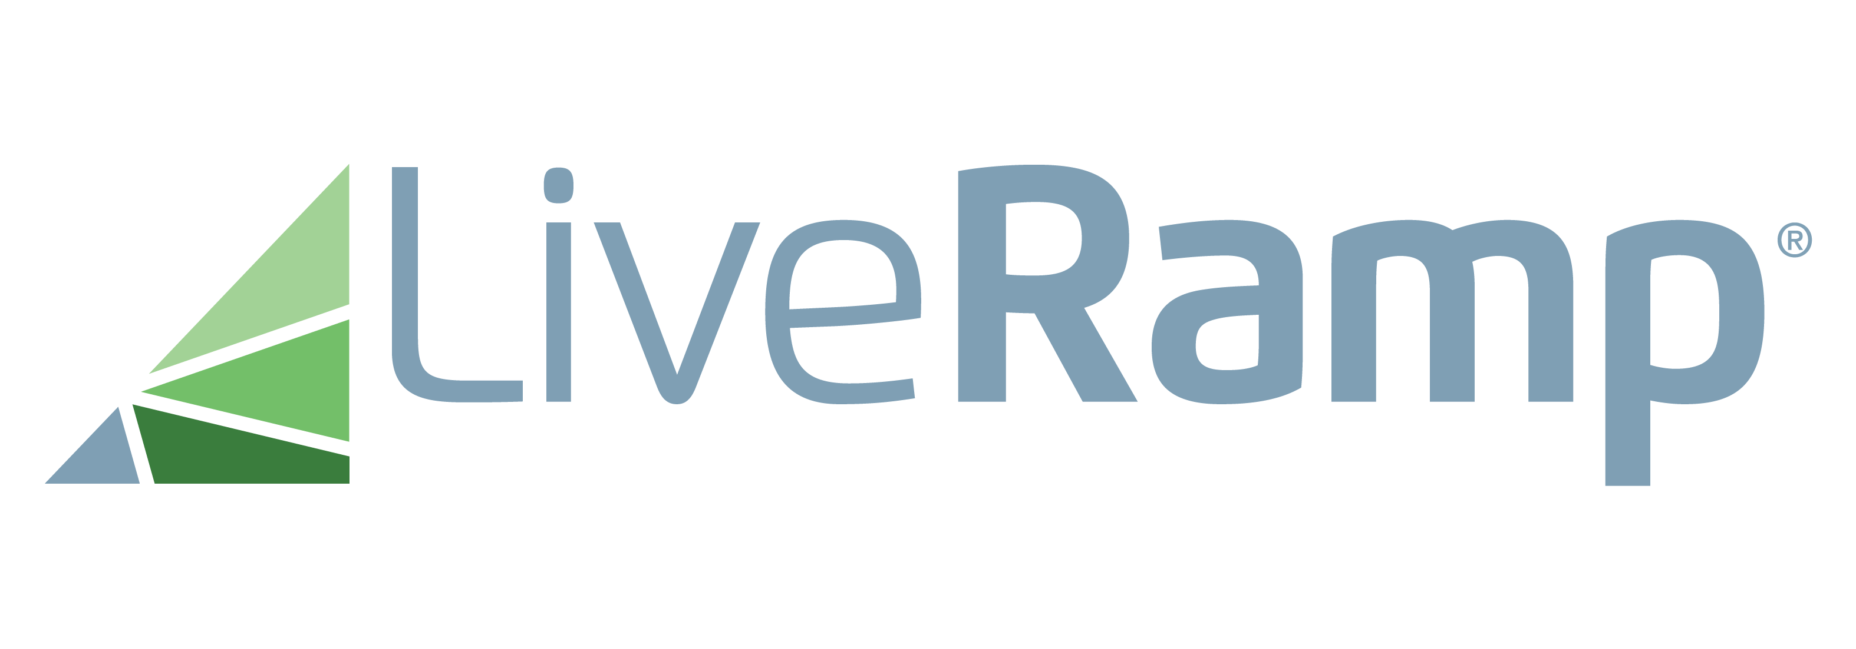
IDENTITY ECOSYSTEM
Enabled by First-party Data
Trade Desk Unified ID
IQiD is Jivox’s proprietary identity graph that offers brands a first-party identity ecosystem
Integrates with Data Management Platforms (DMP) and Customer Data Platforms (CDP)
Integrates with external/ customer user IDs such as The Trade Desk Unified ID and LiveRamp’s RampID
Provides brands data from multiple IDs for analytics and attribution
Proprietary Customer ID
RampID
Jivox IQiD
Log data with one or more IDs
Analytics & attribution
CDP ID
DMP iD

